Slide 1

Data 606 Final Project Presentation
By: Mubashira Qari

Slide 2
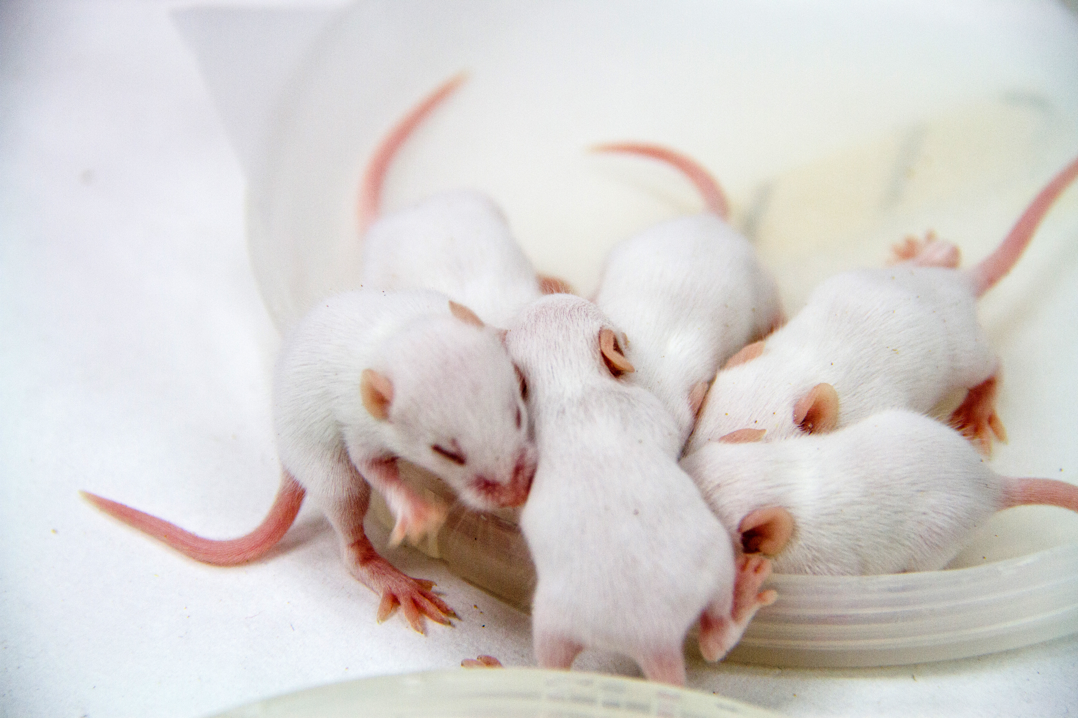
Overview:
Pymaceuticals Inc., a fictional pharmaceutical company specializes in drug-based, anti-cancer pharmaceuticals. They have provided the data to test the efficacy of potential drug treatments for squamous cell carcinoma. In this study, 249 mice identified with Squamous cell carcinoma (SCC) tumor growth, kind of skin cancer, were treated through a variety of drug regimens. Over the course of 45 days, tumor development was observed and measured. The objective is to analyze the data to show how four treatments (Capomulin, Infubinol, Ketapril, and Placebo) compare.
Notes:
This is an experimental study where a group of 249 mice were monitored after administrating a variety of drug regimens over a 45-day treatment period. The impact of Capomulin drug on tumor growth, and survival rates were monitored, along with Infubinol, Ketapril, and Placebo.
There are 10 different drug treatments.
Four drug treatments: Capomulin, Infubinol, Ketapril, and Placebo.
Sample size of mice is 25 for each drug of interest.

Slide 3
Research Question
Question 1: Is Capomulin effective more effective in reducing the tumor size than Infubinol, or Ketapril?
Question 2: Is there a correlation between the age, weight and the tumor size growth for each drug category?
Hypothesis Test
Null Hypothesis: There is no difference between the mean percent change in tumor volume for the four drug categories.
Alternate Hypothesis: There is a difference between the mean percent change in tumor volume for the four drug categories.
Notes:
Approach for answering the research question will be:
1- Calculate the mean percent change in tumor volume for the four drug categories.
2- Perform the One-Way Variance (Anova) Hypothesis test to find out whether or not the difference exist between the mean tumor size for all four drug categories.
3- Perform linear regression to study the correlation between various variables by calculating the correlation coefficient.
4- Finally analyze the results to find out if Capomulin more or less effective in reducing the tumor size of sample mice than Infubinol, or Ketapril.

Slide 4
Response & Explanatory Variable
The response variable is the size of tumor, “Tumor.Volume..mm3.” and it holds a numerical data.(being measured)
The explanatory variable are the “Drug.Regimen” which holds a categorical data and “Timepoint” which holds numerical data. The ‘Timepoint’ unit is days.
Notes:
The two datasets, metadata and results are read into Rmd file and merged together.
After thorough exploratory data analysis and cleaning of data, the summary statistics are calculated.
The initial Tumor Volume at starting timepoint zero is 45 mm3 for all mice.

Slide 5
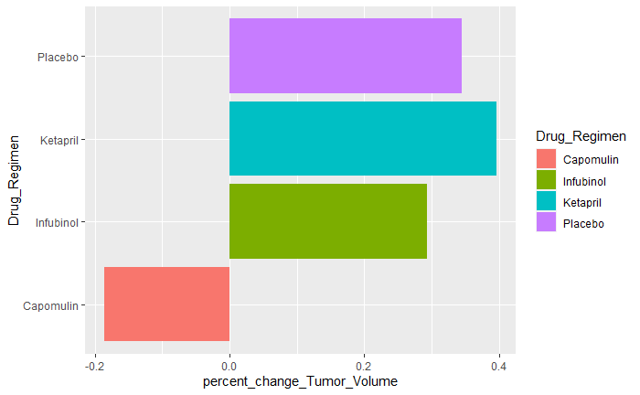
Drug Categories Vs Percent Change in Tumor Volume

Slide 6
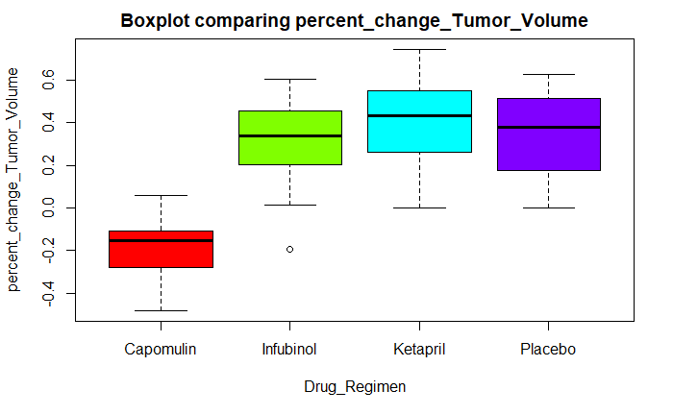
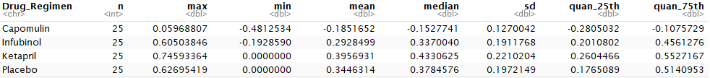
Summary Statistics
Notes:
### Analysis for the box plots:
The drug categories represented on the x_axis and percent change in tumor size on the y_axis.
Infubinol drug category has one datapoint indicating the outlier.
Infubinol and Ketapril shows that the median and mean are closely alligned, which shows data is normally distributed, and we can ignore the outlier in Infubinol.
Ketapril drug category has more variance of data points than the Infubinol drug category.
The mean < median for the Capomulin, is making it left skewed. Also, the percent change is tumor size is below zero, showing that the Capomulin is effective in reducing the size of the tumor.
Since Capomulin appears to be different than Infubinol and Ketapril, this is an indication that we will find the difference between means of Capomulin and the other two categories.

Slide 7
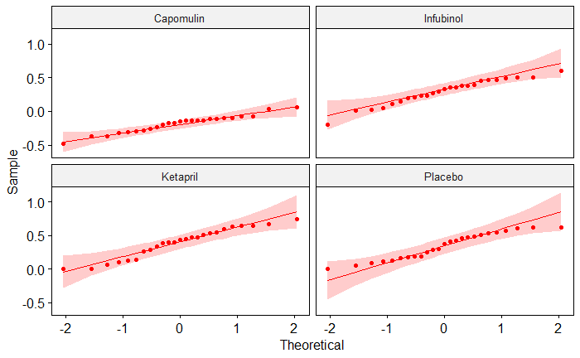
QQ plot and Shapiro-Wilk test of normality
Notes:
### To compare the means of three or more samples, One Way Variance (Anova) is the most appropriate test to use.
### Here I am performing the test of normality.
The ANOVA test makes a few assumptions about the data:
Independence of the observations. Each subject should belong to only one group.
No significant outliers in any group
Normality. the data for each group should be approximately normally distributed.
Homogeneity of variances. The variance of the outcome variable should be equal in every group.

Slide 8
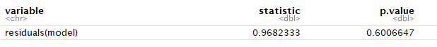
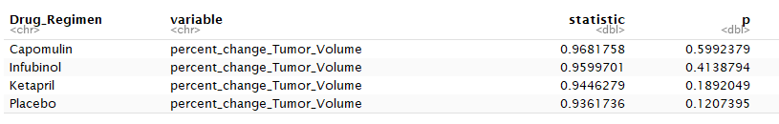
Shapiro-Wilk test of normality
Check normality assumption by groups
Notes:
Here I am performing a Shapiro-Wilk test of normality
In the QQ plot that I showed previously, all the points fall approximately along the reference line, so we can assume normality.
This conclusion is supported by the Shapiro-Wilk test.
The p-value is not significant (p = 0.6), so we can assume normality.
The score were normally distributed (p > 0.05) for each group, as assessed by Shapiro-Wilk’s test of normality.

Slide 9
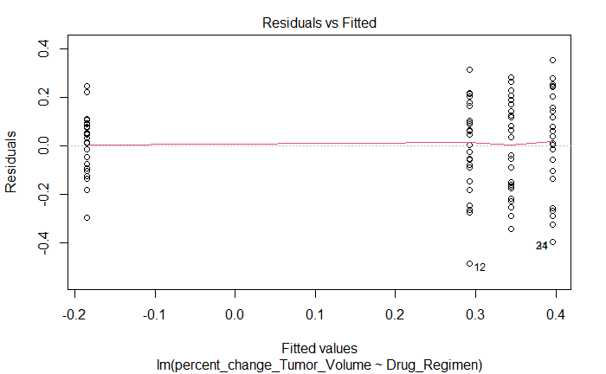
Homogeneity of variance assumption
Notes:
In the plot above, there is no evident relationships between residuals and fitted values (the mean of each groups), which is good. So, we can assume the homogeneity of variances.

Slide 10
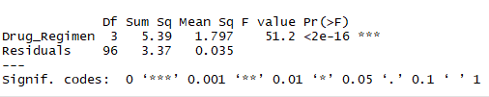
Hypothesis Test
Step 1: Setup Null Hypothesis and Alternate Hypothesis
H0 = mu0 = mu01 = mu02 = mu03 (There is no difference between the mean percent change in tumor volume for the four drug categories.)
H1 = Not all means are equal
Alpha = 0.05
Notes:
### Report:
Degree of freedom: 3, since we have 4 categories, so 4-1 =3 degree of freedom
Sum of Squares: 5.3104
Mean Sum of Squares: 1.7701
F-Statistics: 69.737, F(3, 96) = 69.74
### Conclusion:
The F-value in an ANOVA is calculated as: variation between sample means / variation within the samples.
The higher the F-value in an ANOVA, the higher the variation between sample means relative to the variation within the samples.
The higher the F-value, the lower the corresponding p-value.
Here the p-Value, tells weather or not we found significance difference or not.
The p-Value: 2.2e-16, less than alpha=0.05 shows that we found the difference in at one of the means in the data sample. And that is what we suspected from the boxplot analysis.
Since the p-value is below a threshold (α = .05), we can reject the null hypothesis of the ANOVA and conclude that there is a statistically significant difference between group means.
Therefore, we can reject the null hypothesis that there is no difference between the means in the data sample.
But we are not sure about which category mean is different, so we perform Post-hoc tests to determine that.

Slide 11
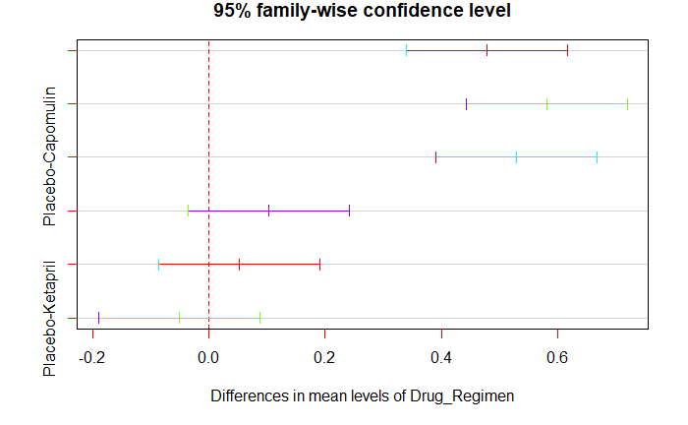
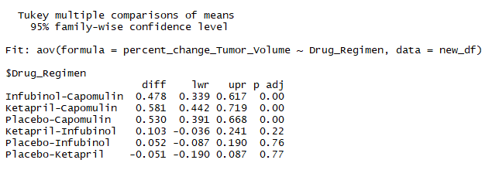
Post-hoc Test
Notes:
A significant one-way ANOVA is generally followed up by Tukey post-hoc tests to perform multiple pairwise comparisons between groups.
### Report TukeyHSD Results:
when p-adj < p-value, there is a significant difference between the two categories mean.
the lwr and upr bounds shows that we are 95% confident that the true mean lies between the lwr and upr bounds of confidence Interval.
The p-Value for Infubinol-Capomulin, Ketapril-Capomulin, Placebo-Capomulin is less than alpha=0.05 and that shows there is significant difference between the means of these categories.
The p-Value for the other three group comparison is greater than alpha=0.05 shows there is no significant difference between the means of these categories.
Thus, we conclude that, Capomulin is more effective in reducing the tumor size than Infubinol, or Ketapril.
In the visualization the middle line on each bar shows the difference in mean for different drug categories .
Both end limits on each bar shows the upper and lower limits of confidence intervals.

Slide 12
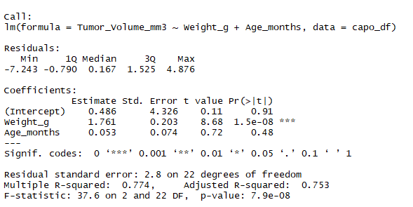
Regression Model for Analyzing Correlation between Age, weight and Tumor_Volume_mm3
Notes:
Regression Model for Analyzing Correlation between Age_months, weight_g and Tumor_Volume_mm3.
When building regression models, we hope that this p-value is less than some significance level because it indicates that the predictor variables are actually useful for predicting the value of the response variable.
we used an alpha level of α = .05 to determine which predictors is significant in this regression model, we’d say that weight is accounting for most of the variance, which has (p=1.49e-08) < is (α = .05) and is statistically significant predictors.
while age (p=0.481 ) > is (α = .05) and is not statistically significant predictors.
Estimate: The estimated coefficient. This tells us the average increase in the response variable associated with a one unit increase in the predictor variable, assuming all other predictor variables are held constant.
Std. Error: This is the standard error of the coefficient. This is a measure of the uncertainty in our estimate of the coefficient.
t value: This is the t-statistic for the predictor variable, calculated as (Estimate) / (Std. Error).
Residual standard error: This tells us the average distance that the observed values fall from the regression line. The smaller the value, the better the regression model is able to fit the data.
I performed the regression test for weight and age verses tumor size separately and come up with the same result in my Rmd file
Adjusted R-squared: This is a modified version of R-squared that has been adjusted for the number of predictors in the model. It is always lower than the R-squared.
F-statistic: This indicates whether the regression model provides a better fit to the data than a model that contains no independent variables. In essence, it tests if the regression model as a whole is useful.

Slide 13
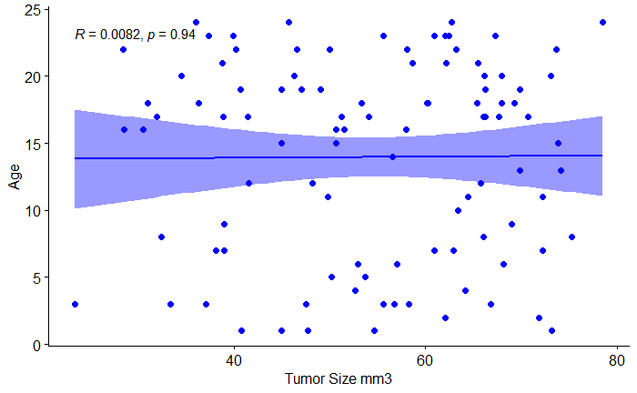
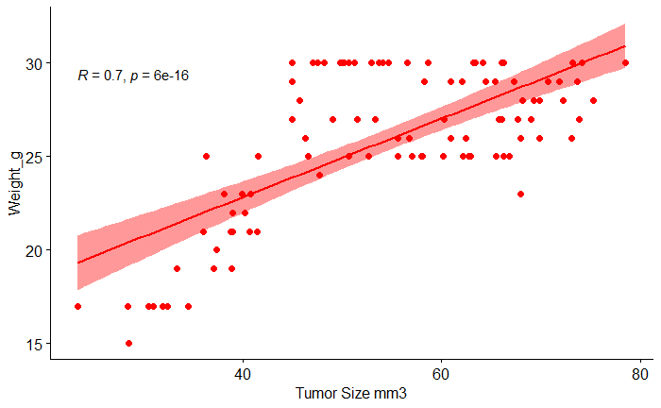
Regression Model for Analyzing Correlation between Age, weight and Tumor_Volume_mm3
Notes:
Multiple R-Squared: This is known as the coefficient of determination. It tells us the proportion of the variance in the response variable that can be explained by the predictor variables. This value ranges from 0 to 1. The closer it is to 1, the better the predictor variables can predict the value of the response variable.
p-value: This is the p-value that corresponds to the F-statistic. If this value is less than some significance level (e.g. 0.05), then the regression model fits the data better than a model with no predictors.

Slide 14
Conclusion
Why is this analysis important?
ANOVA test determines the difference in mean between two or more independent groups.
It provides the overall test of equality of group means.
It can control the overall type I error rate (i.e., false positive finding)
Limitations of the analysis?
One-way ANOVA can only be used when investigating a single factor and a single dependent variable. When comparing the means of three or more groups, it can tell us if at least one pair of means is significantly different, but it can't tell us which pair.
ANOVA assumes that the data is normally distributed. The ANOVA also assumes homogeneity of variance, which means that the variance among the groups should be approximately equal. ANOVA also assumes that the observations are independent of each other.
Notes:
ANOVA (or AOV) is short for ANalysis Of VAriance. While it is commonly used for categorical data, because ANOVA is a type of linear model it can be modified to include continuous data.
ANOVAs are typically referred to as 1-way and 2-way, which is just a way of saying how many factors are being examined in the model. (ANOVAs can be 3-way or more, but these are less common or end up with different names.) A factor is the categorical variable that you are evaluating, and the different categories within the factor are often called levels or groups.
ANOVA test determines the difference in mean between two or more independent groups.
ANOVA checks the impact of one or more factors by comparing the means of different samples. We can use ANOVA to prove/disprove if all the medication treatments were equally effective or not.
ANOVA analyzes the variance in the data to look for differences. It does this by considering two sources of variance, the between-group variance and the within-group variance.
The between-group variation is calculated by comparing the mean of each group with the overall mean of the data—so individual data points don’t matter quite as much as just comparing group means.
The within-group variation is the variation of each observation from its group mean.
For both types of variance, a sums of squares (SS) is the numerical metric used to quantify them and this metric simply sums the distances of each point to the mean.
The ratio of these SS (between SS divided by within SS) results in an F-statistic, which is the test statistic for ANOVA.
The F-statistic is then combined with the degrees of freedom (df) to arrive at a p-value, which, we are looking for.
Another way to think of it is that small p-values come from large F-statistics, and large F-statistics suggest that the between group variance is much larger than the within-group variance.
So, when the differences in group means is larger and yet the groups are not that variable, we tend to have significant factors in our ANOVAs.
A type 1 error is also known as a false positive and occurs when a researcher incorrectly rejects a true null hypothesis. This means that your report that your findings are significant when in fact they have occurred by chance.
The probability of making a type I error is represented by your alpha level (α), which is the p-value below which you reject the null hypothesis. A p-value of 0.05 indicates that you are willing to accept a 5% chance that you are wrong when you reject the null hypothesis.
You can reduce your risk of committing a type I error by using a lower value for p. For example, a p-value of 0.01 would mean there is a 1% chance of committing a Type I error.
However, using a lower value for alpha means that you will be less likely to detect a true difference if one really exists (thus risking a type II error).

Slide 15
Data Source Links
The datasets are provided by Pymaceuticals Inc.. Below is the link for the original source of the datasets:
https://c-l-nguyen.github.io/web-design-challenge/index.html
The raw datasets are imported from the GitHub links provided below:
https://raw.githubusercontent.com/rfpoulos/pymaceuticals/master/data/Mouse_metadata.csv
https://raw.githubusercontent.com/rfpoulos/pymaceuticals/master/data/Study_results.csv

